Slide 1
Networks in Comm Research
Empirical Applications and Examples
Alvin Zhou, JOUR 818, 10/24/2022

Slide 2
How to use networks in comm research
Network to present/describe social phenomena
Semantic networks
Network visualization
Network measures as IVs for predictions
Centrality/brokerage/… serve as IVs in regressions
Network as DV to be predicted
ERGM and its variants
Network as structures for other inquiries
Network simulation
Network experiment

Slide 3
How to use networks in comm research
Network to present/describe social phenomena
Semantic networks
Network visualization
Network measures as IVs for predictions
Centrality/brokerage/… serve as IVs in regressions
Network as DV to be predicted
ERGM and its variants
Network as structures for other inquiries
Network simulation
Network experiment

Slide 4
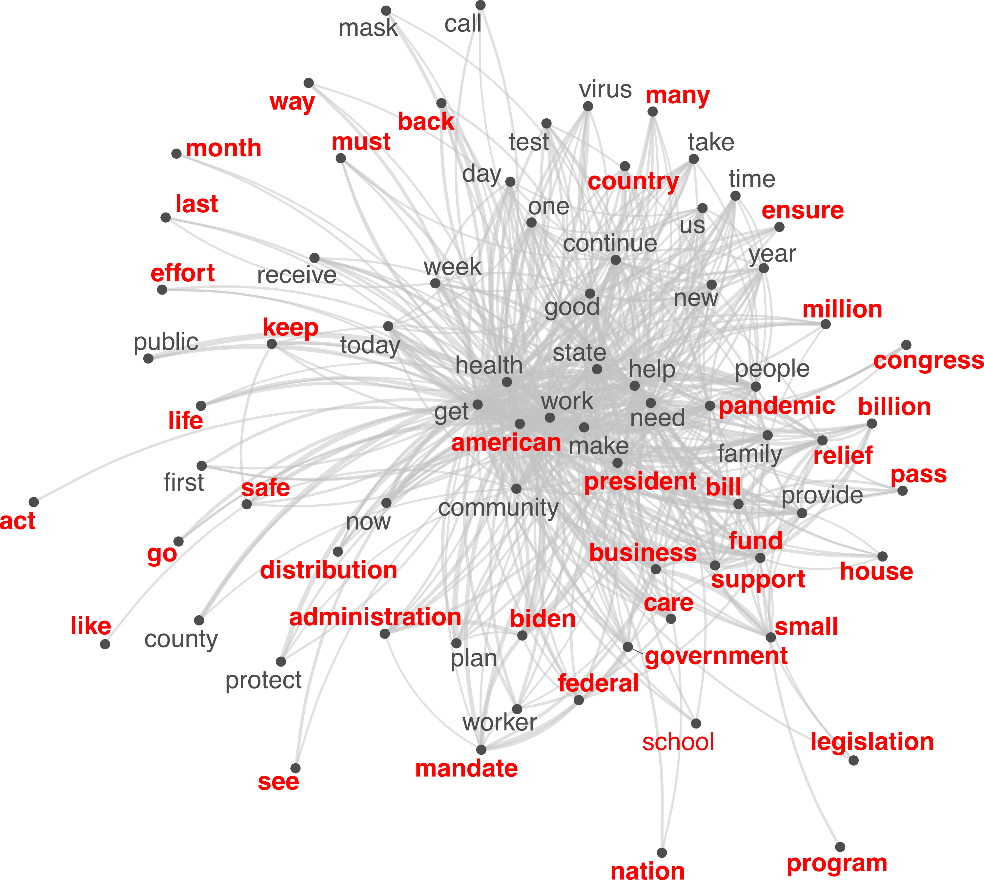
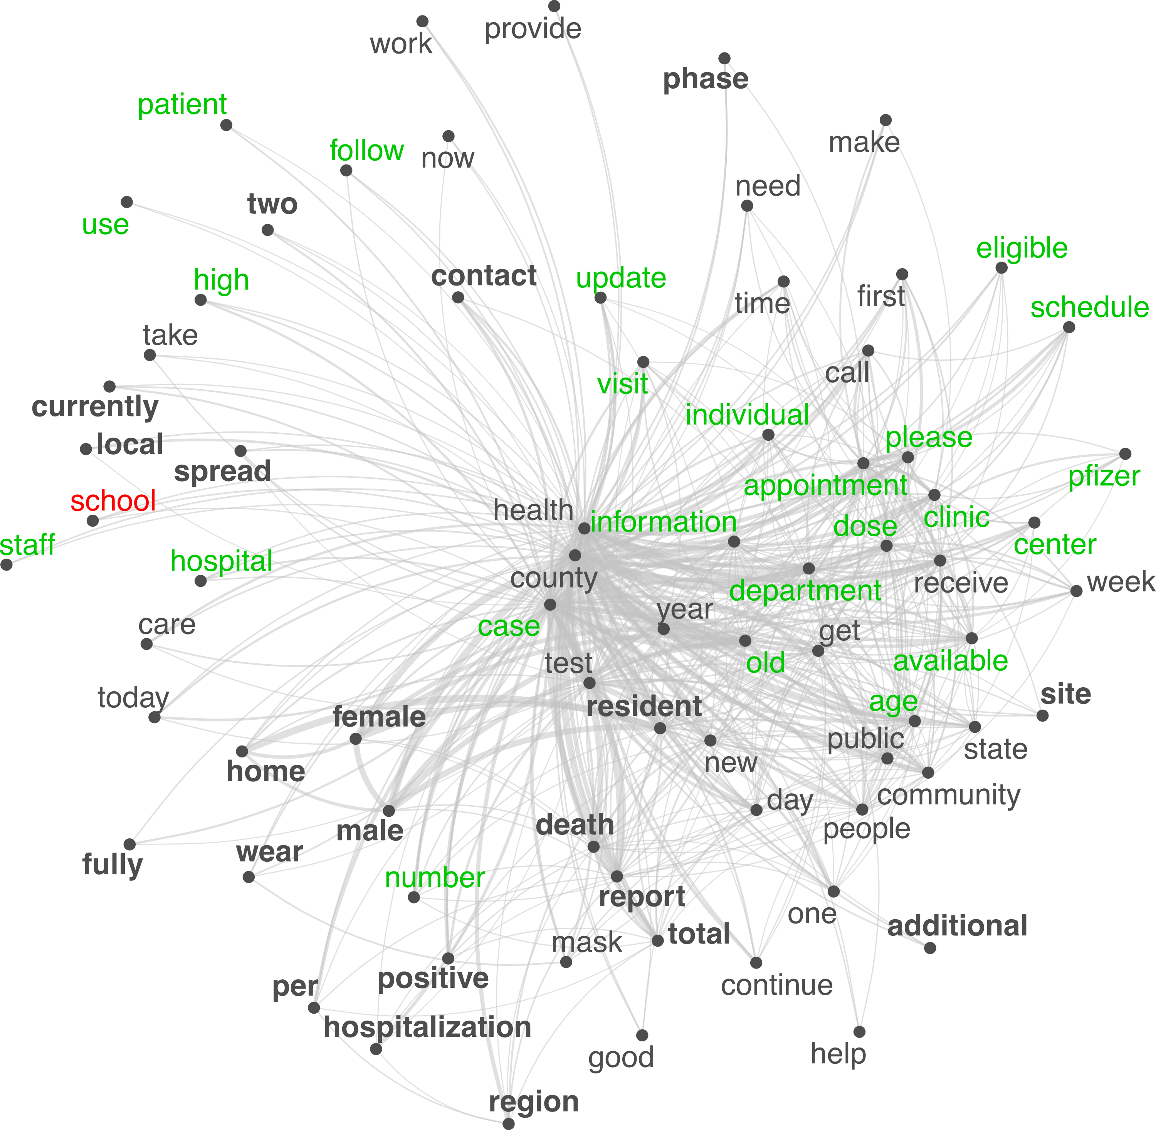
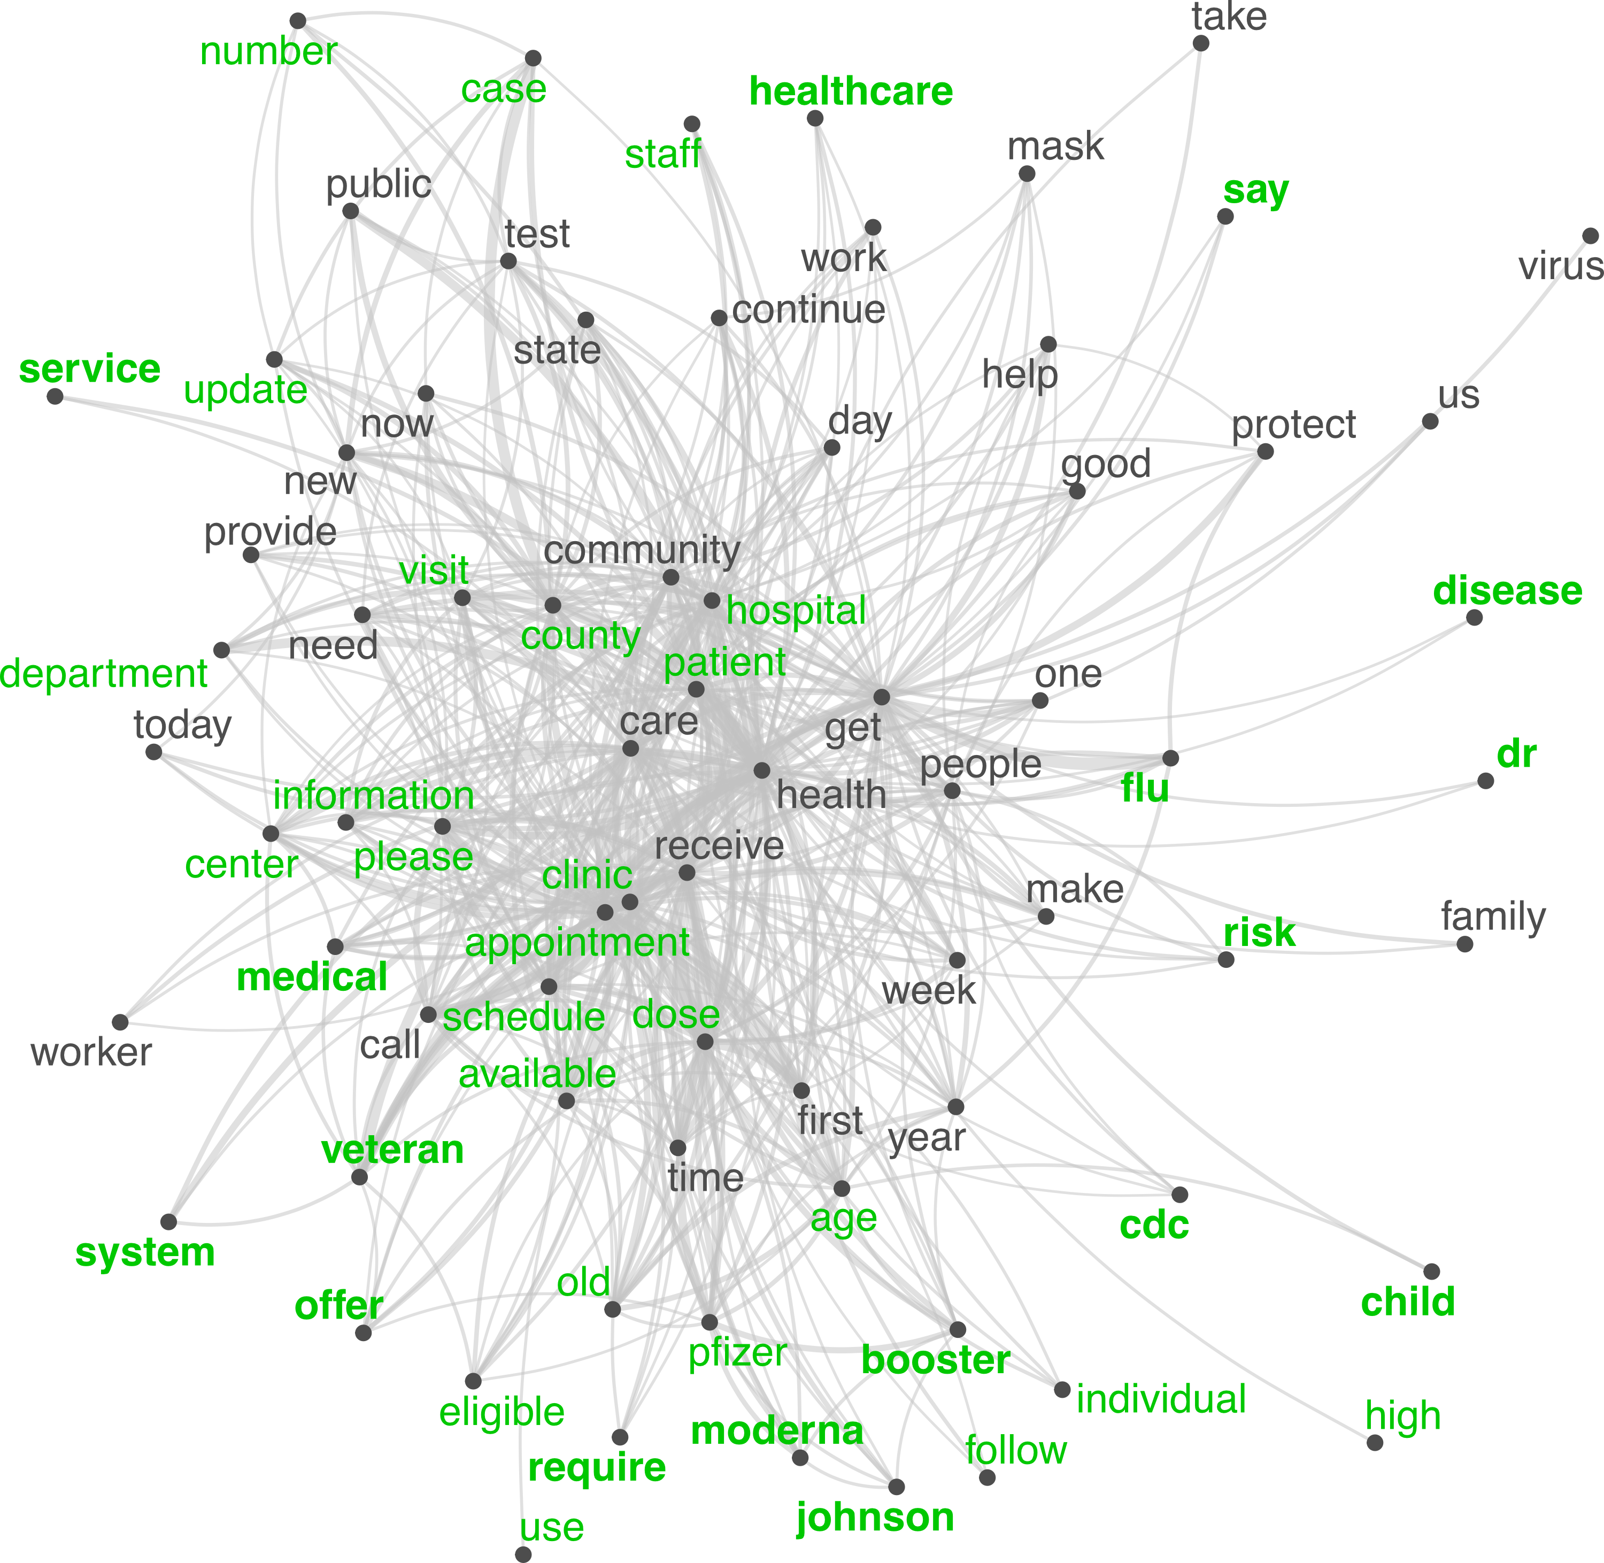
Semantic Networks
Words/terms as nodes; co-appearance as ties; Easily represent textual information.
Three semantic networks showing how politicians, government agencies, and doctors talk about COVID-19 vaccines.
Zhou, A., Liu, W., & Yang, A. (R&R). Playing politics or straight talk of science?: Comparing politicization of COVID-19 vaccines by U.S. politicians, medical experts, and government agencies on social media. Political Communication.

Slide 5
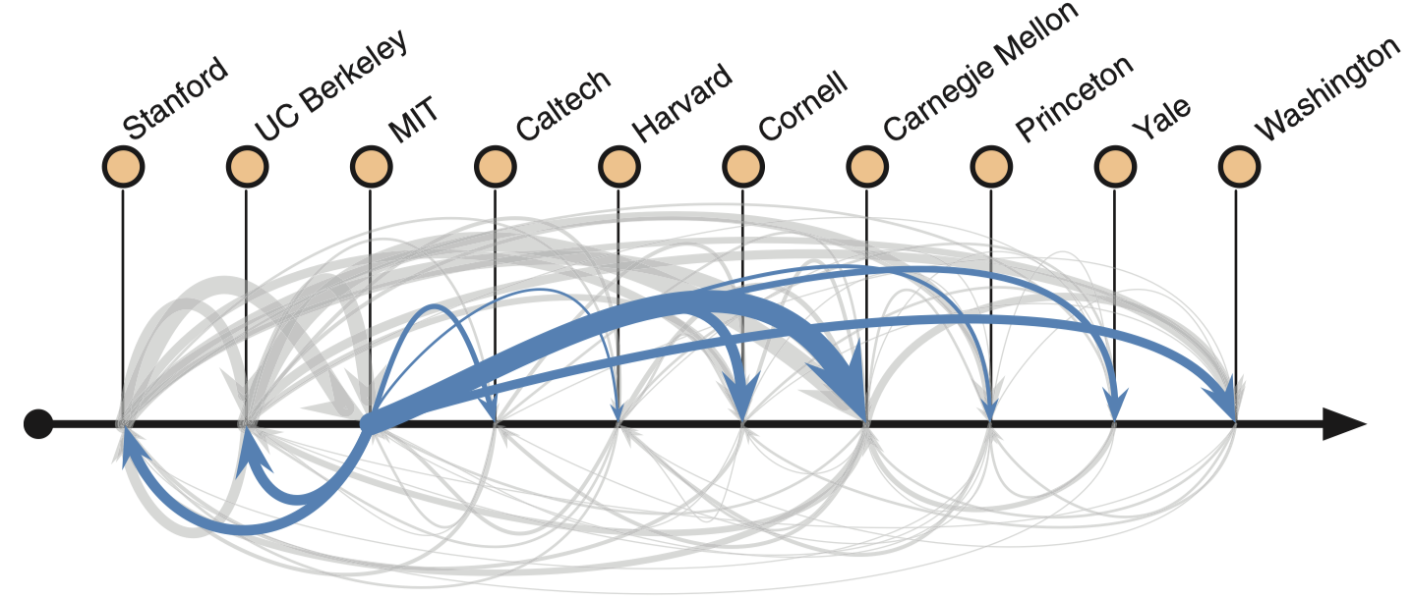
Network Visualization
Convey arguments on networking phenomena.
Hiring networks among prestigious CS PhD programs.
Clauset, A., Arbesman, S., & Larremore, D. B. (2015). Systematic inequality and hierarchy in faculty hiring networks. Science Advances, 1(1), e1400005.

Slide 6
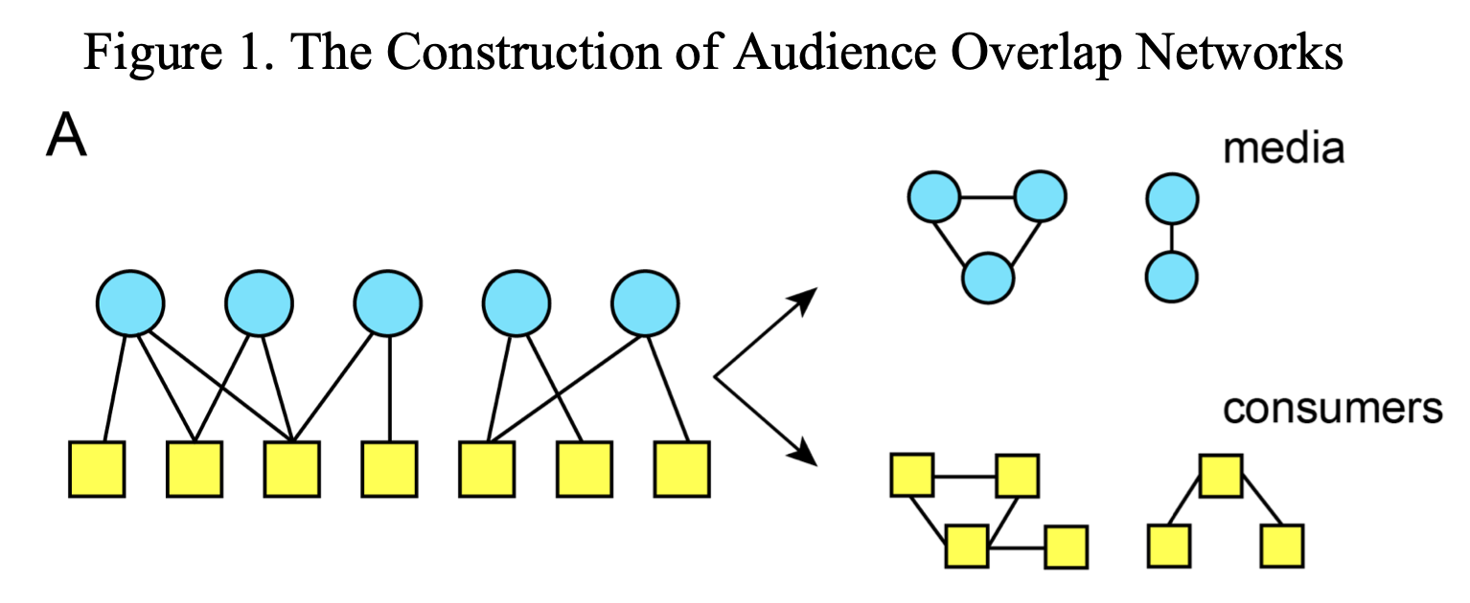
Network Visualization
Convey arguments on networking phenomena.
Dual-projection networks.
Mukerjee, S., Majó-Vázquez, S., & González-Bailón, S. (2018). Networks of audience overlap in the consumption of digital news. Journal of Communication, 68(1), 26–50.

Slide 7
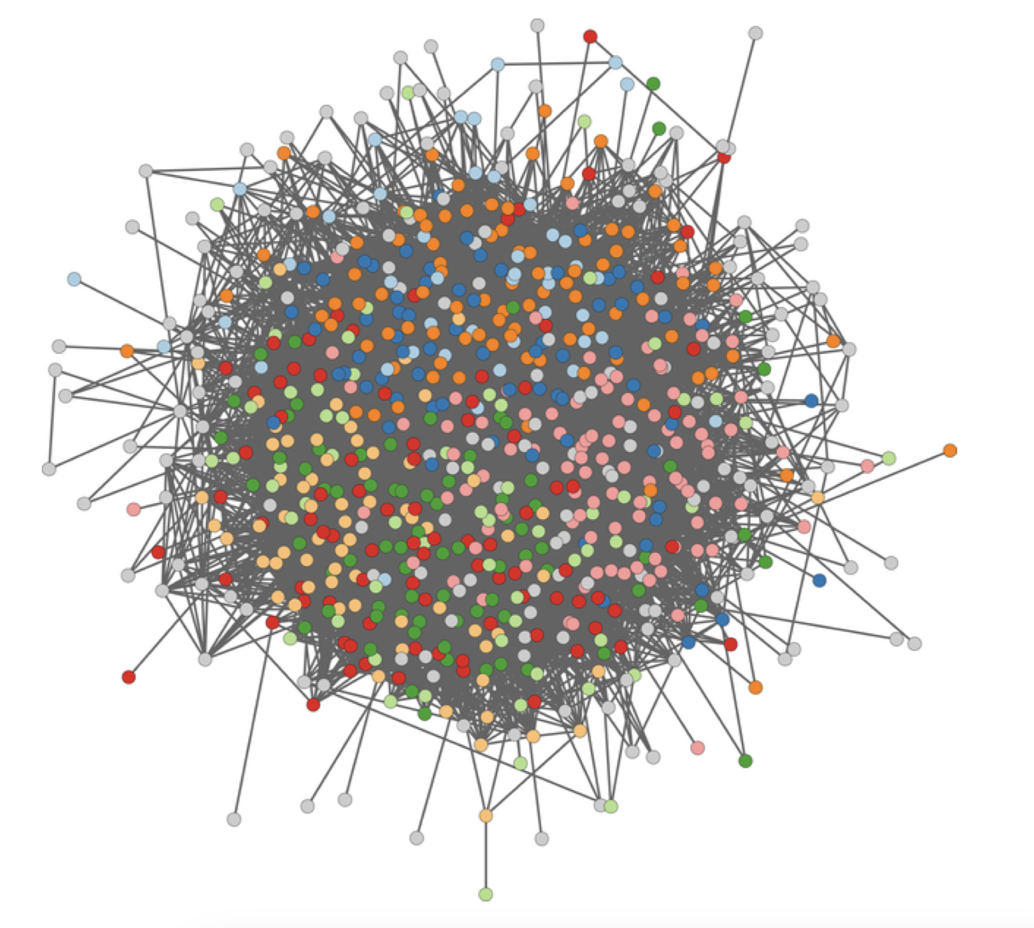
Network Visualization
Convey arguments on networking phenomena.
Avoid hairball visualizations that convey little information.
Venturini, T., Jacomy, M., & Jensen, P. (2021). What do we see when we look at networks: Visual network analysis, relational ambiguity, and force-directed layouts. Big Data & Society, 8(1), 205395172110184.
Nocaj, A., Ortmann, M., & Brandes, U. (2015). Untangling the hairballs of multi-centered, small-world online social media networks. Journal of Graph Algorithms and Applications, 19(2), 595–618.
Use filtering techniques (e.g., backbone extraction) / color / size / force-directed layouts, etc

Slide 8
How to use networks in comm research
Network to present/describe social phenomena
Semantic networks
Network visualization
Network measures as IVs for predictions
Centrality/brokerage/… serve as IVs in regressions
Network as DV to be predicted
ERGM and its variants
Network as structures for other inquiries
Network simulation
Network experiment

Slide 9
How to use networks in comm research
Network to present/describe social phenomena
Semantic networks
Network visualization
Network measures as IVs for predictions
Centrality/brokerage/… serve as IVs in regressions
Network as DV to be predicted
ERGM and its variants
Network as structures for other inquiries
Network simulation
Network experiment

Slide 10
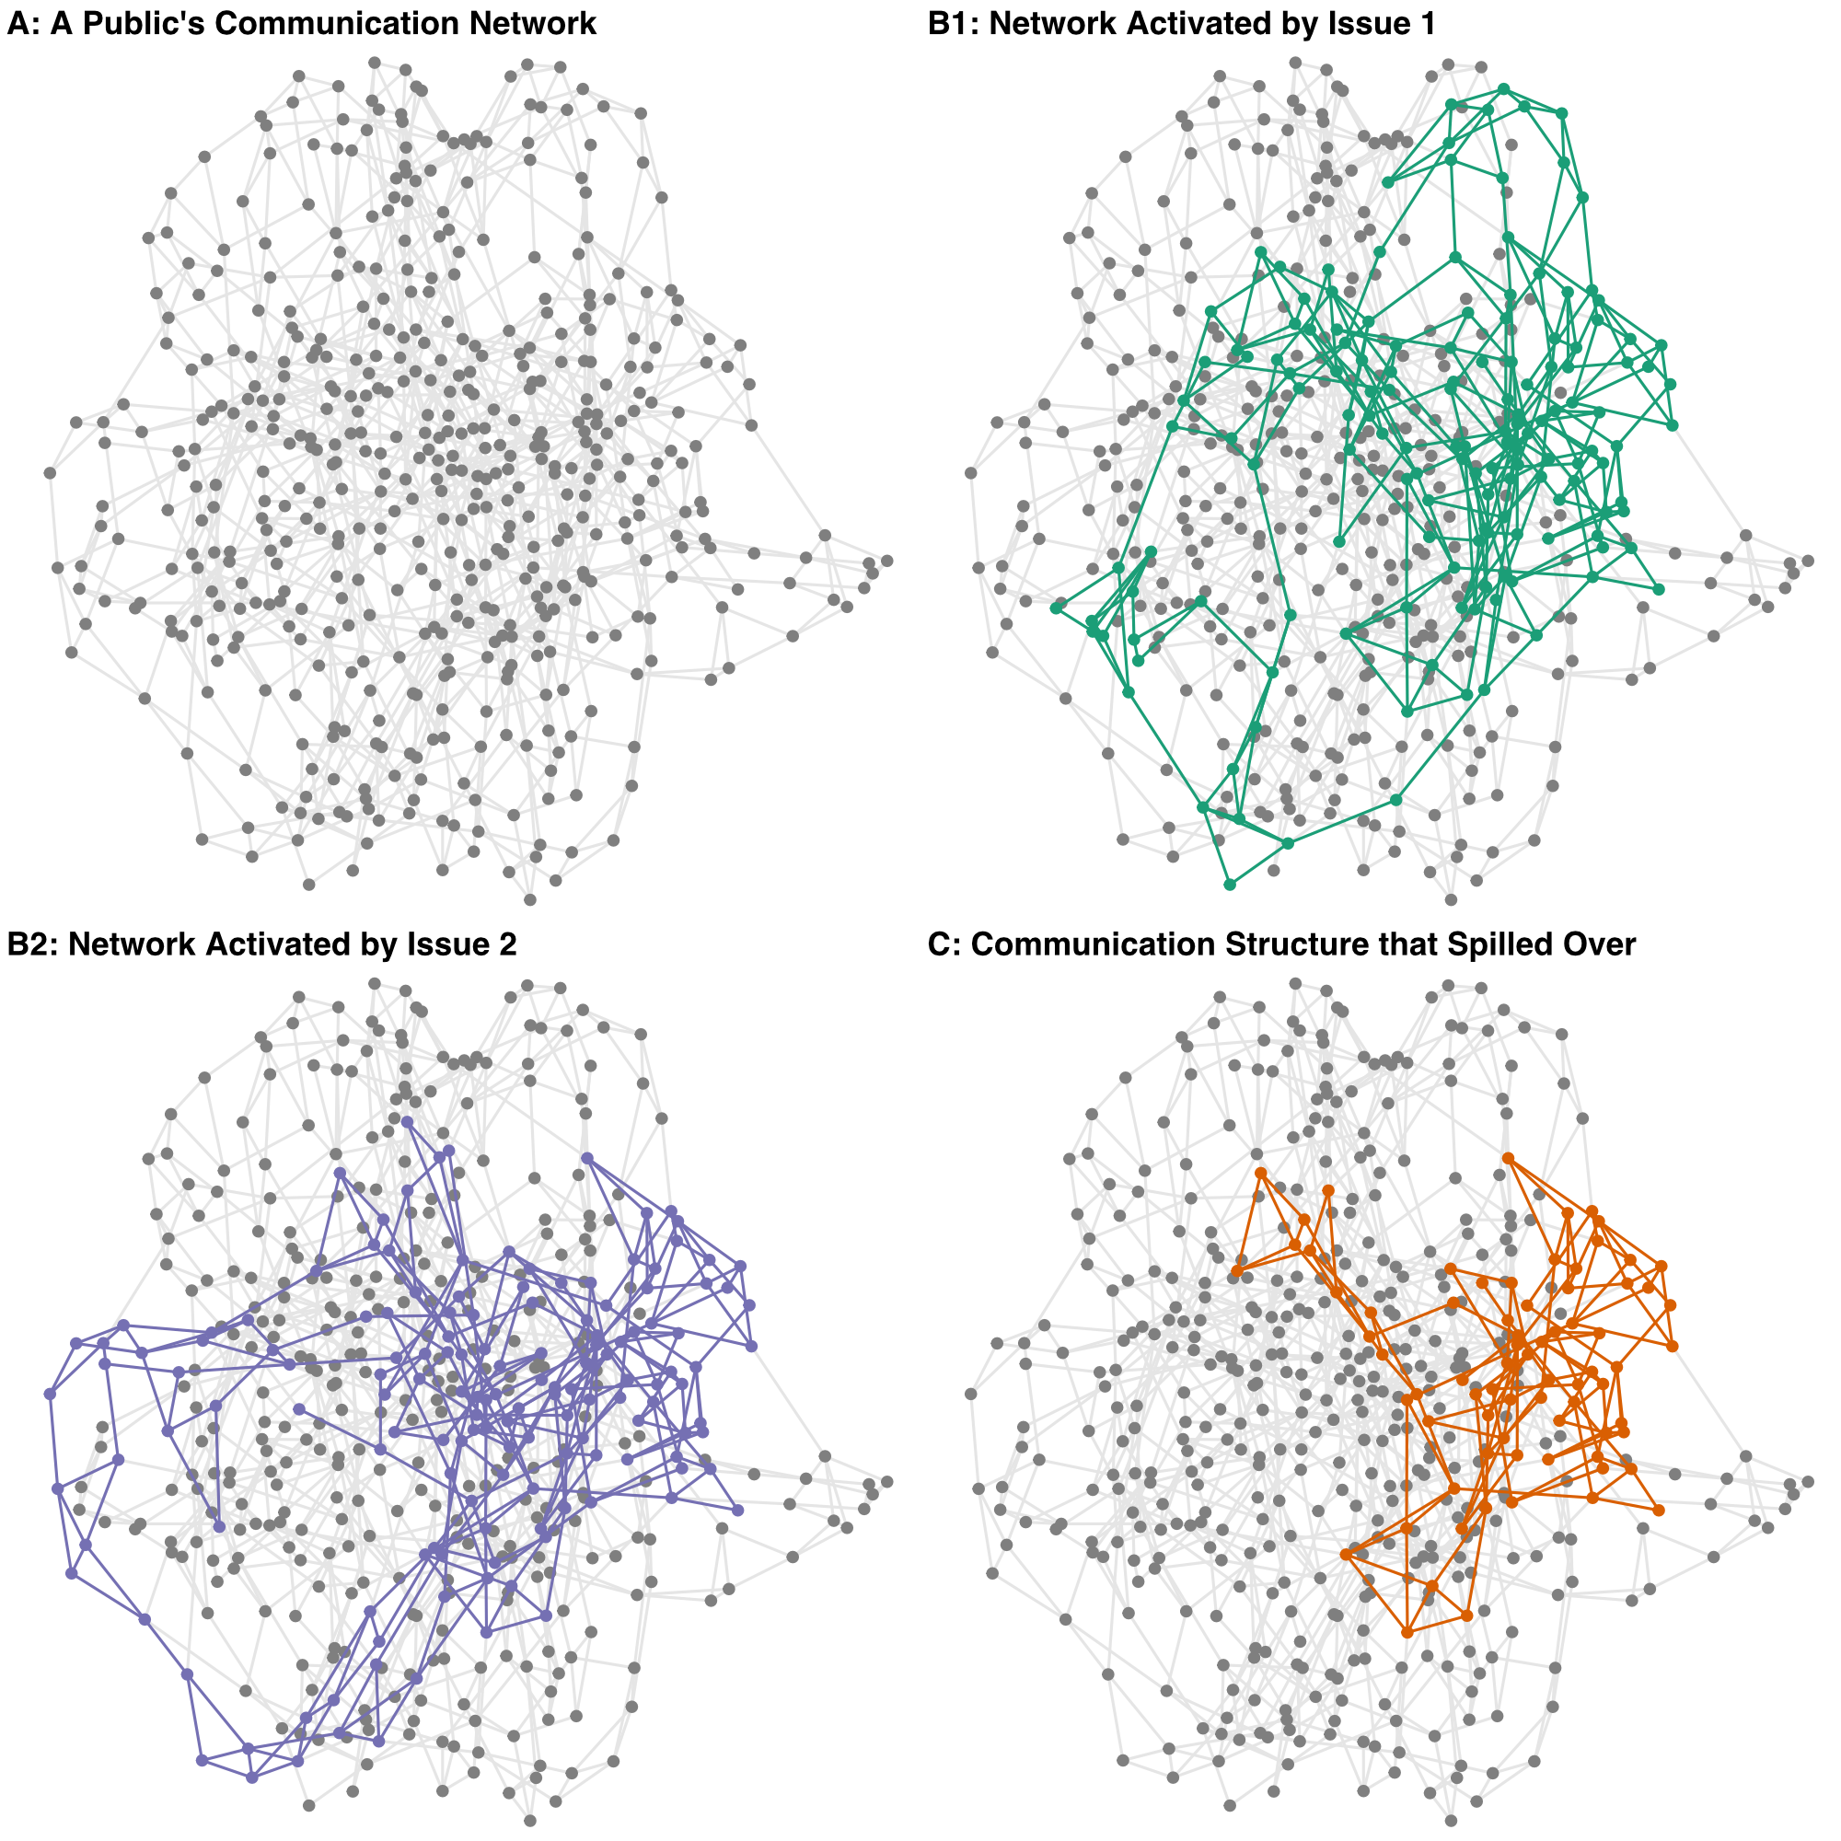
Network measures as IVs
Zhou, A., & Yang, A. (2021). The longitudinal dimension of social-mediated movements: Hidden brokerage and the unsung tales of movement spilloverers. Social Media + Society, 7(3), 205630512110475.
Users that appeared in #ClimateMarch (2014) appeared again in #MarchForOurLives (2018)
Long history of movement spillover literature in sociology (Meyer & Whittier, 1994)
The paper tries to:
Describe the phenomenon on social media
Discuss its potential driver (issue sorting)
Explore its implications

Slide 11
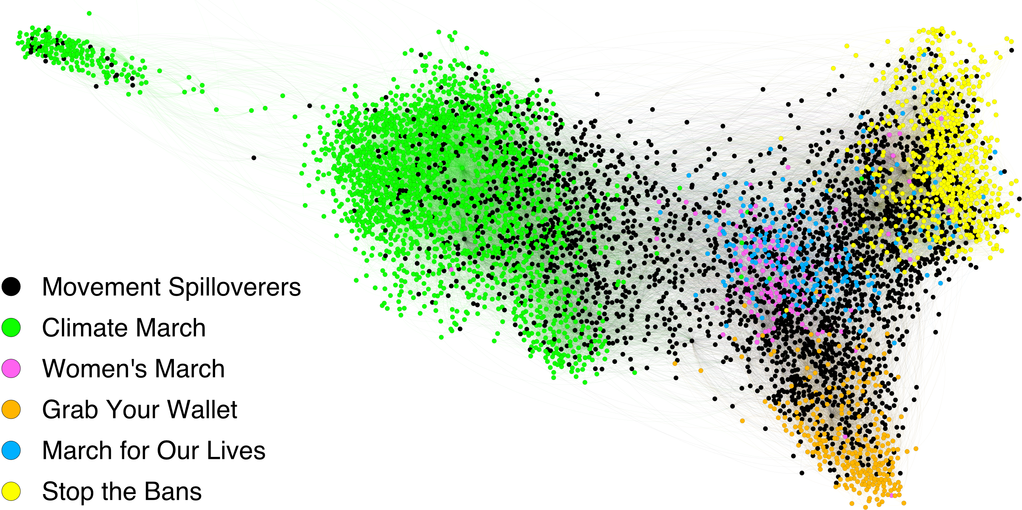
Network measures as IVs
Data: five waves of hashtag-based Twitter data #ClimateMarch, #WomensMarch, #GrabYourWallet, #MarchForOurLives, & #StoptheBans
Analysis:
Find users that appeared in >=2 movements
e.g., 12.86% of the #GrabYourWallet participants showed up in #MarchForOurLives
Visualize with igraph and Gephi

Slide 12
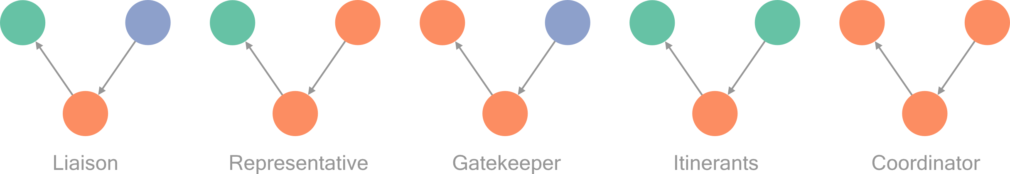
Network measures as IVs
Data: five waves of hashtag-based Twitter data #ClimateMarch, #WomensMarch, #GrabYourWallet, #MarchForOurLives, & #StoptheBans
Analysis:
Find users that appeared in >=2 movements
e.g., 12.86% of the #GrabYourWallet participants showed up in #MarchForOurLives
Visualize with igraph and Gephi
Calculate four network measures brokerage with sna as IVs

Slide 13
Network measures as IVs
Data: five waves of hashtag-based Twitter data #ClimateMarch, #WomensMarch, #GrabYourWallet, #MarchForOurLives, & #StoptheBans
Analysis:
Find users that appeared in >=2 movements
e.g., 12.86% of the #GrabYourWallet participants showed up in #MarchForOurLives
Visualize with igraph and Gephi
Calculate four network measures brokerage with sna as IVs
Calculate number of retweets and number of retweets by media/politicians/activists as DVs

Slide 14
Network measures as IVs
Data: five waves of hashtag-based Twitter data #ClimateMarch, #WomensMarch, #GrabYourWallet, #MarchForOurLives, & #StoptheBans
Analysis:
Find users that appeared in >=2 movements
e.g., 12.86% of the #GrabYourWallet participants showed up in #MarchForOurLives
Visualize with igraph and Gephi
Calculate four network measures brokerage with sna as IVs
Calculate number of retweets and number of retweets by media/politicians/activists as DVs
DV ~ IV1+IV2+IV3+IV4 + fixed effects for username + fixed effects for spillover instances

Slide 15
Network measures as IVs
Data: five waves of hashtag-based Twitter data #ClimateMarch, #WomensMarch, #GrabYourWallet, #MarchForOurLives, & #StoptheBans
Analysis:
Find users that appeared in >=2 movements
e.g., 12.86% of the #GrabYourWallet participants showed up in #MarchForOurLives
Visualize with igraph and Gephi
Calculate four network measures brokerage with sna as IVs
Calculate number of retweets and number of retweets by media/politicians/activists as DVs
DV ~ IV1+IV2+IV3+IV4 + fixed effects for username + fixed effects for spillover instances
We find:
Movement spillover is widespread and deserves a deeper look
The general public and media like to retweet itinerants and representatives
Politicians like to retweet coordinators
Activists like to retweet representatives

Slide 16
Network measures as IVs
Yang, A., & Saffer, A. J. (2021). Standing out in a networked communication context: Toward a network contingency model of public attention. New Media & Society, 23(10), 2902–2925.
Larson, J. M., Nagler, J., Ronen, J., & Tucker, J. A. (2019). Social networks and protest participation: Evidence from 130 million Twitter users. American Journal of Political Science, 63(3), 690–705.
Xu, Y., Fulk, J., & Monge, P. (2021). Ecological influences on network tie dissolution in the evolution of affiliation networks in the International Communication Association, 2009–2015. Human Communication Research, 47(1), 75–103.

Slide 17
How to use networks in comm research
Network to present/describe social phenomena
Semantic networks
Network visualization
Network measures as IVs for predictions
Centrality/brokerage/… serve as IVs in regressions
Network as DV to be predicted
ERGM and its variants
Network as structures for other inquiries
Network simulation
Network experiment

Slide 18
How to use networks in comm research
Network to present/describe social phenomena
Semantic networks
Network visualization
Network measures as IVs for predictions
Centrality/brokerage/… serve as IVs in regressions
Network as DV to be predicted
ERGM and its variants
Network as structures for other inquiries
Network simulation
Network experiment

Slide 19
Network as DV to be predicted
We observed a network, then we ask:
What nodal attributes, between-node forces, and network tendencies might have existed that contributed to the observed network?

Slide 20
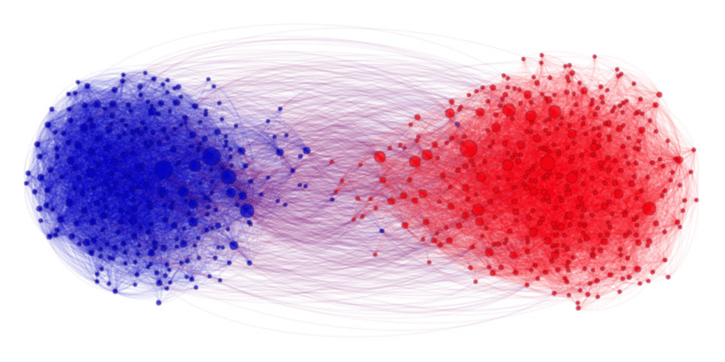
Network as DV to be predicted
We observed a network, then we ask:
What nodal attributes, between-node forces, and network tendencies might have existed that contributed to the observed network?
For example:
See this network as a DV
What predictor might have been significant?

Slide 21
Network as DV to be predicted
We observed a network, then we ask:
What nodal attributes, between-node forces, and network tendencies might have existed that contributed to the observed network?
Similar to logistic regression: ERGMs predict the probability that a pair of nodes in a network will have a tie between them, with a set of IVs.

Slide 22
Network as DV to be predicted
We observed a network, then we ask:
What nodal attributes, between-node forces, and network tendencies might have existed that contributed to the observed network?
Similar to logistic regression: ERGMs predict the probability that a pair of nodes in a network will have a tie between them, with a set of IVs.
Control variables: edges (constant term, i.e., probability of tie formation); gender; age; etc.
Nodal attributes: NGOs’ issue focus; political party; etc.
Homophily tendencies: same gender; age difference; same hashtags; etc.
Structural parameters: reciprocity, transitivity, i.e., 2-star, 3-star, triangle, etc.

Slide 23
Network as DV to be predicted
We observed a network, then we ask:
What nodal attributes, between-node forces, and network tendencies might have existed that contributed to the observed network?
Similar to logistic regression: ERGMs predict the probability that a pair of nodes in a network will have a tie between them, with a set of IVs.
Control variables: edges (constant term, i.e., probability of tie formation); gender; age; etc.
Nodal attributes: NGOs’ issue focus; political party; etc.
Homophily tendencies: same gender; age difference; same hashtags; etc.
Structural parameters: reciprocity, transitivity, i.e., 2-star, 3-star, triangle, etc.
ERGMs can be used for directed, undirected, valued, unvalued, and bipartite networks, thus many variants.

Slide 24
Network as DV to be predicted
Xu, S., & Zhou, A. (2020). Hashtag homophily in twitter network: Examining a controversial cause-related marketing campaign. Computers in Human Behavior, 102, 87–96.
Huang, Y., Shen, C., & Contractor, N. S. (2013). Distance matters: Exploring proximity and homophily in virtual world networks. Decision Support Systems, 55(4), 969–977.
Sommerfeldt, E. J., Saffer, A. J., & Luoma-aho, V. (2022). Civil society networks and Malaysian government reform: Considering issue homophily in interorganizational relationships. Journal of Communication, 72(2), 264–296.
Shumate, M., & Palazzolo, E. T. (2010). Exponential random graph (p*) models as a method for social network analysis in communication research. Communication Methods and Measures, 4(4), 341–371.

Slide 25
How to use networks in comm research
Network to present/describe social phenomena
Semantic networks
Network visualization
Network measures as IVs for predictions
Centrality/brokerage/… serve as IVs in regressions
Network as DV to be predicted
ERGM and its variants
Network as structures for other inquiries
Network simulation
Network experiment

Slide 26
How to use networks in comm research
Network to present/describe social phenomena
Semantic networks
Network visualization
Network measures as IVs for predictions
Centrality/brokerage/… serve as IVs in regressions
Network as DV to be predicted
ERGM and its variants
Network as structures for other inquiries
Network simulation
Network experiment

Slide 27
Network as structures for other inquiries
Network experiments
Inviting online workers to participate in studies and assigning them with different network structures or network positions.
Testing the causal impact of network structures on social outcomes.

Slide 28
Network as structures for other inquiries
Network experiments
Inviting online workers to participate in studies and assigning them with different network structures or network positions.
Testing the causal impact of network structures on social outcomes.
Network simulations
Another way to test causality
If we take out some social forces, what a null network would have looked like?
What deviance exists between the observed network and the null network?

Slide 29
Network as structures for other inquiries
Network experiments
Inviting online workers to participate in studies and assigning them with different network structures or network positions.
Testing the causal impact of network structures on social outcomes.
Network simulations
Another way to test causality
If we take out some social forces, what a null network would have looked like?
What deviance exists between the observed network and the null network?
Zhou, A., Capizzo, L. W., Page, T. G., & Toth, E. L. (R&R). Exploring public relations research topics and inter-cluster dynamics through computational modeling (2010-2020). Journal of Public Relations Research.
To review a decade’s scholarship and see how they are connected: review paper with a twist

Slide 30
Network as structures for other inquiries
Network simulations
Data:
Two journals: Public Relations Review (PRR), Journal of Public Relations Research (JPRR)
Scrape: 1,093 papers from PRR and 200 from JPRR; In total 7,400,685 words

Slide 31
Network as structures for other inquiries
Network simulations
Data:
Two journals: Public Relations Review (PRR), Journal of Public Relations Research (JPRR)
Scrape: 1,093 papers from PRR and 200 from JPRR; In total 7,400,685 words
Analyses:
STM: Clustered 65 topics into 9 themes (“Twitter” and “Facebook” clustered as “Digital Media”; “crisis” and “image repair” clustered as “Crisis Communication”)
Consider a paper as a combination of themes (“This is a 40% crisis communication + 20% digital media + 10% employee communication + etc.”) and a conduit through which each theme is introduced to each other — thus creating a network.

Slide 32
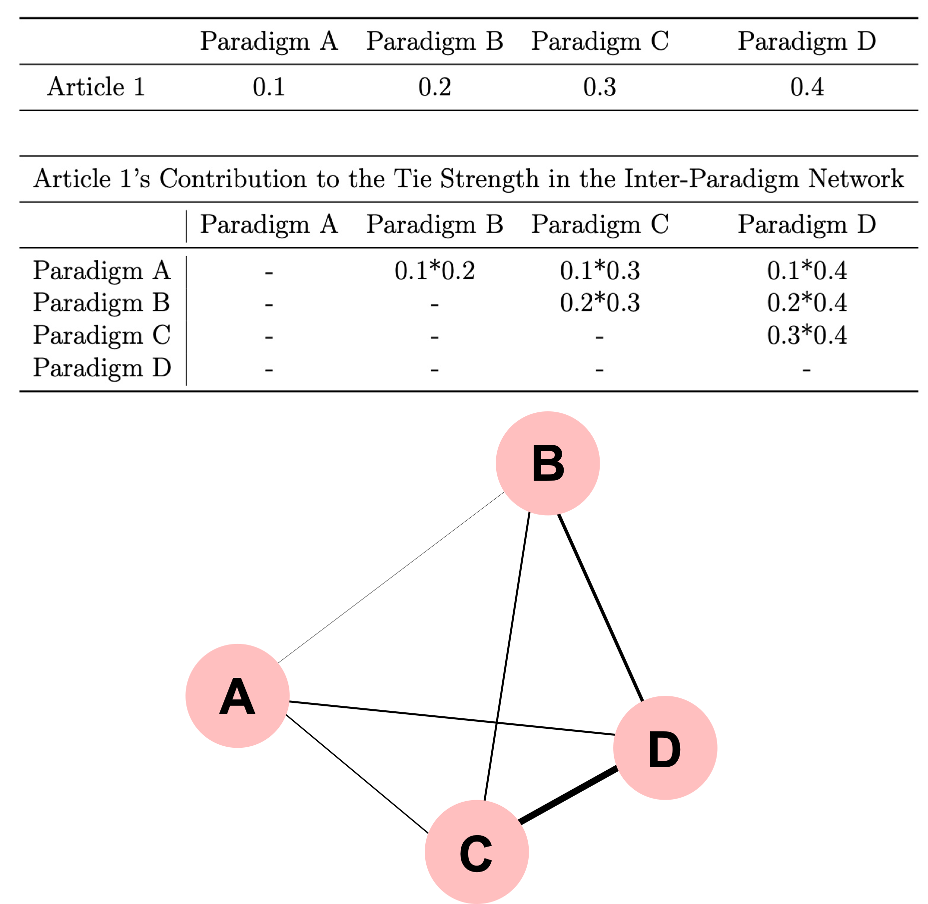
Network as structures for other inquiries

Slide 33
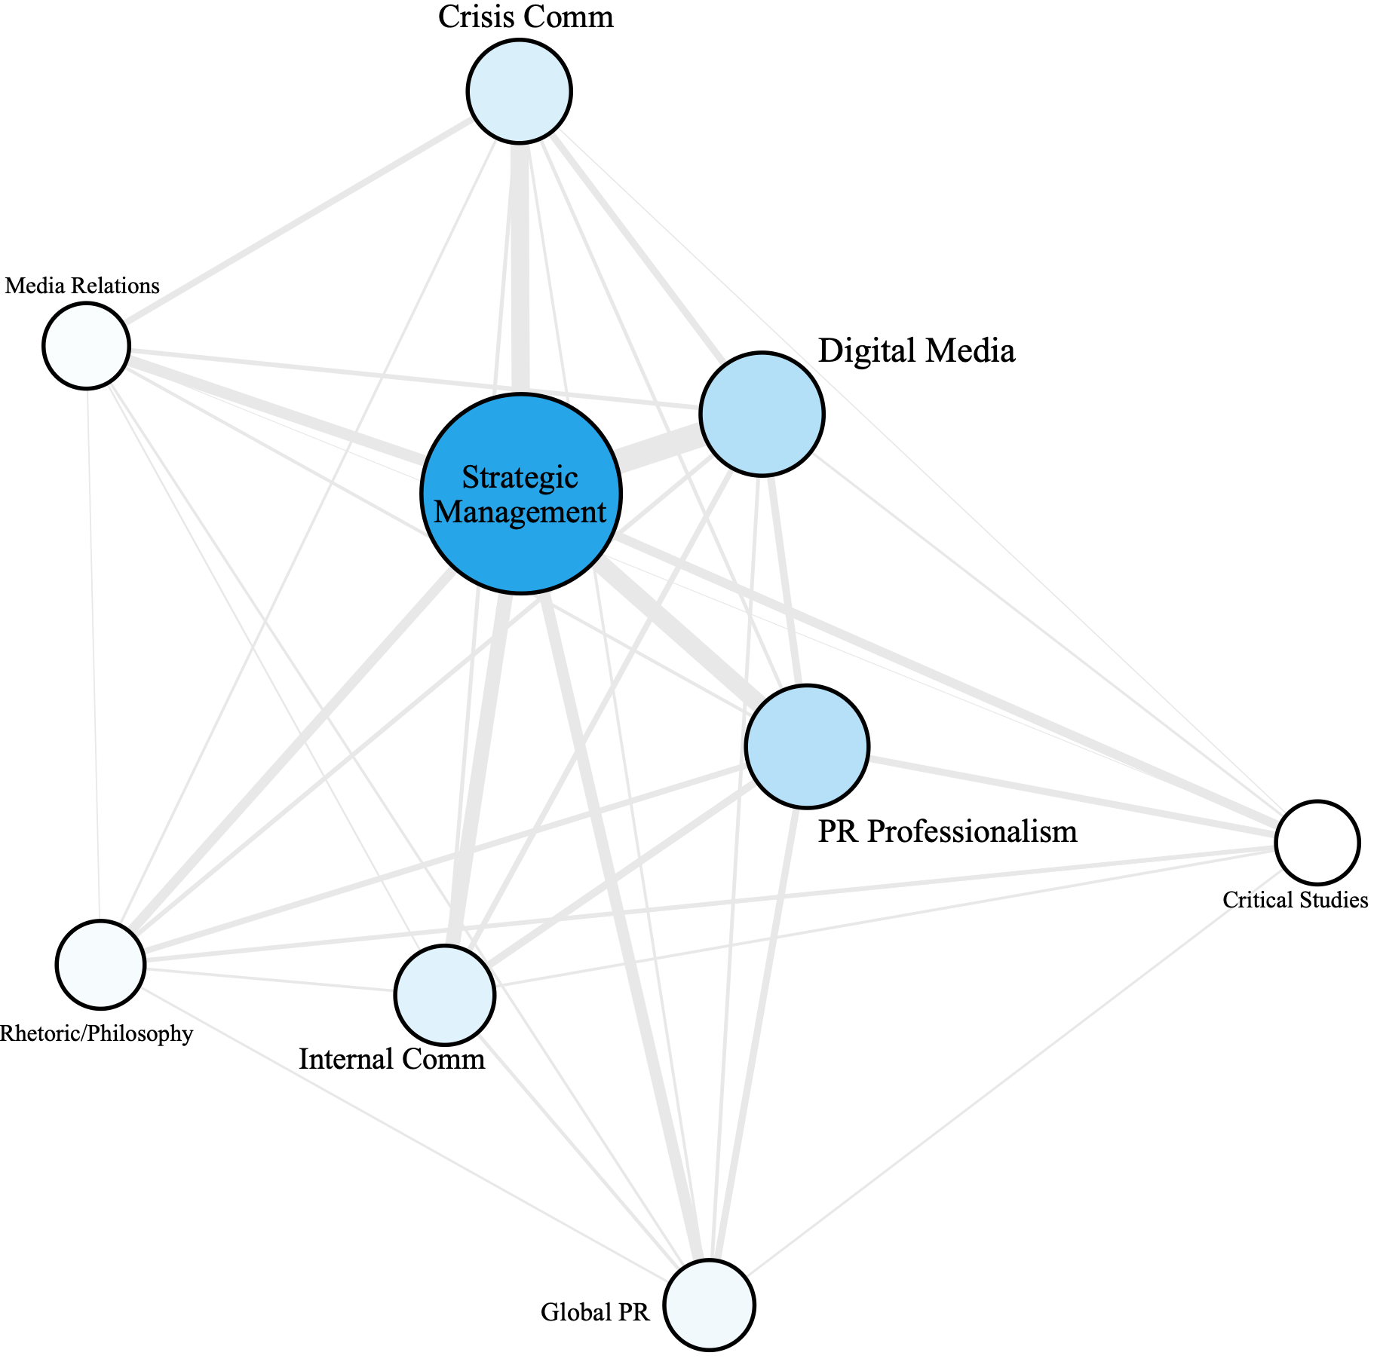
Network as structures for other inquiries

Slide 34
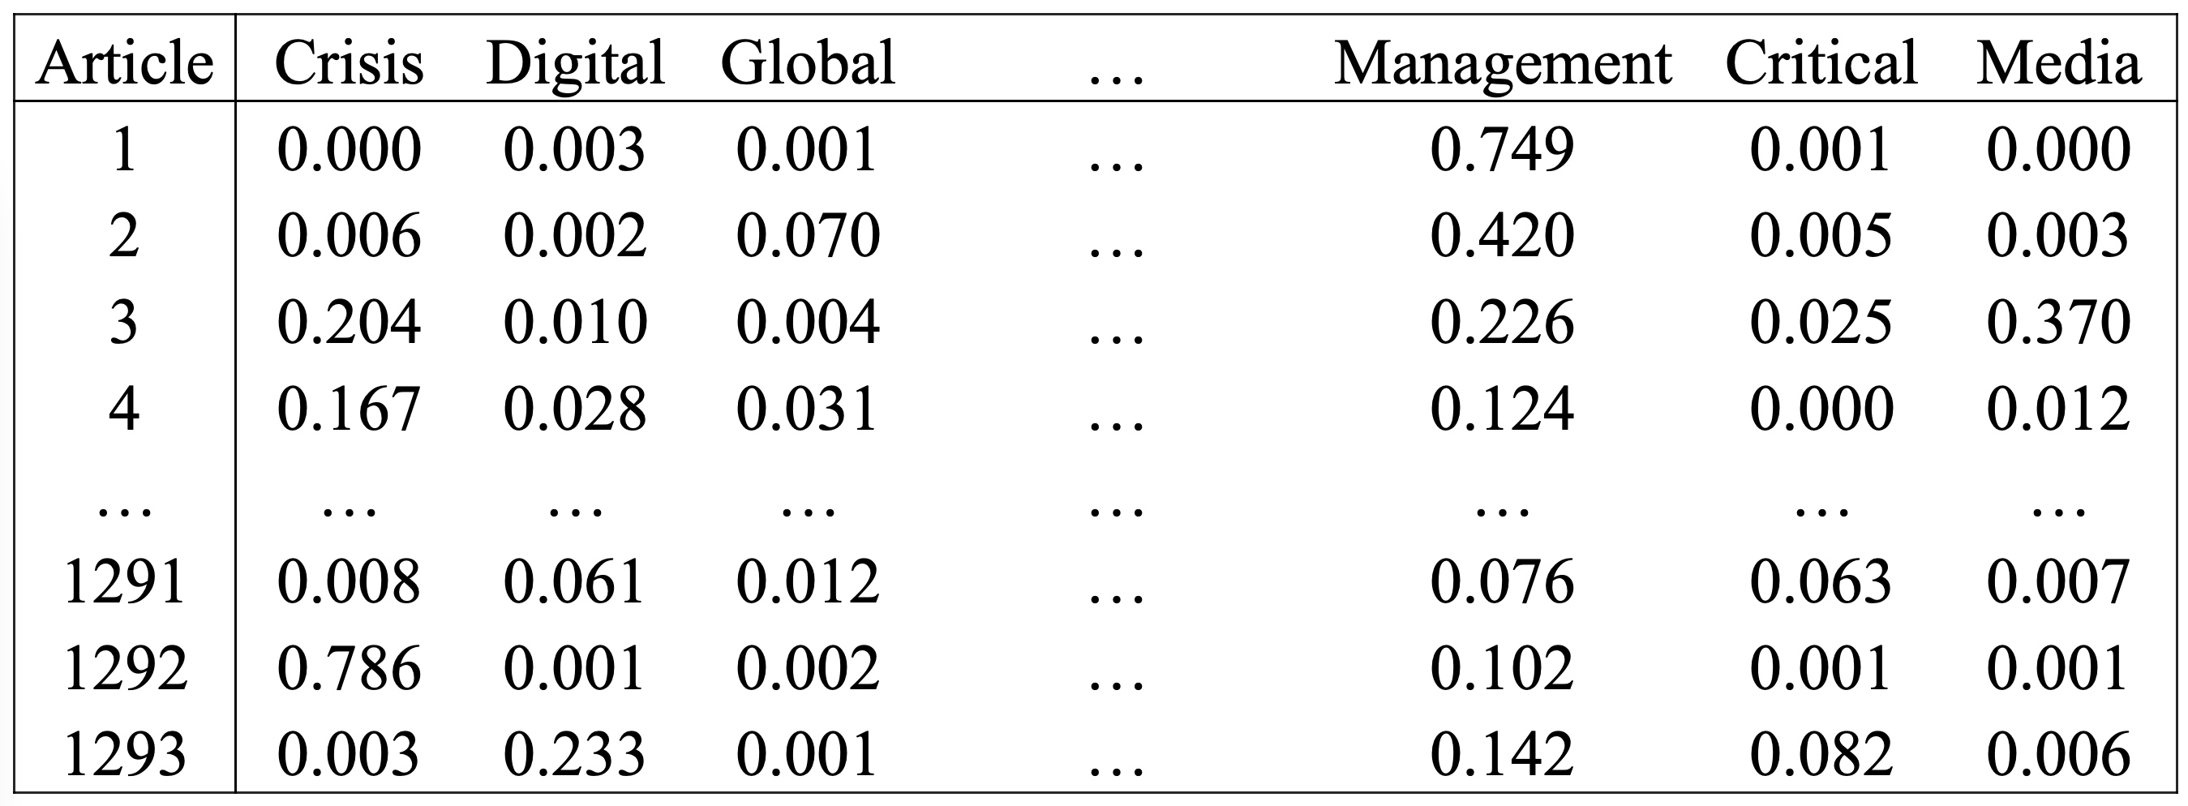
Network as structures for other inquiries
Notes:
To test what the field *could have* be, we go into study 4 where we implemented network simulation. Going back to our dataset, we have 1293 articles, and 9 paradigms, basically 1293 rows, and 9 columns. Then we introduce random noises to this table.

Slide 35
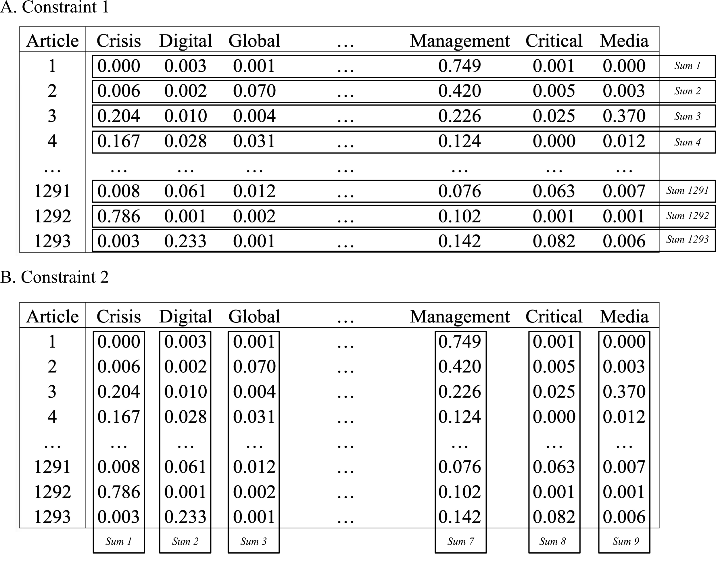
Network as structures for other inquiries
1000 Simulated Universes
1000 Simulated Networks
95%/5% upper/lower bound as the confidence interval for tie strengths
We simulated “what public relations scholarship’ interconnection should have been”
Notes:
While keeping the row sum and column sum the same for each simulation. In other words, in a parallel universe, the most central subfield will still be the most central, we are only changing subfields’ interconnections between each other.
We simulated 1000 parallel universes, build a network for each of the universe, and considered the 95% and 5% upper and lower bound as the confidence intervals for tie strengths. In other words, we simulated “what interconnection of public relations subfields should be” and compare it with what we observed from our real data.

Slide 36
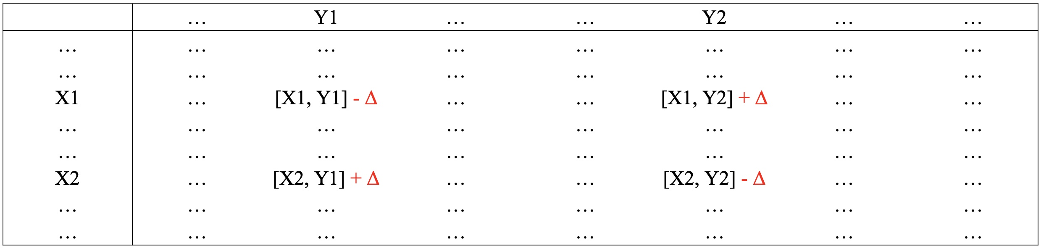
Network as structures for other inquiries
R, bipartite package, decimalr2dtable function
Notes:
Back to our computational talk, we take the data frame of 1293 rows and 9 columns, randomly select four cells, randomly pick a numeric noise, add the noise or subtract the noise from the diagonal cells, so that the row sum and column sum remain the same.

Slide 37
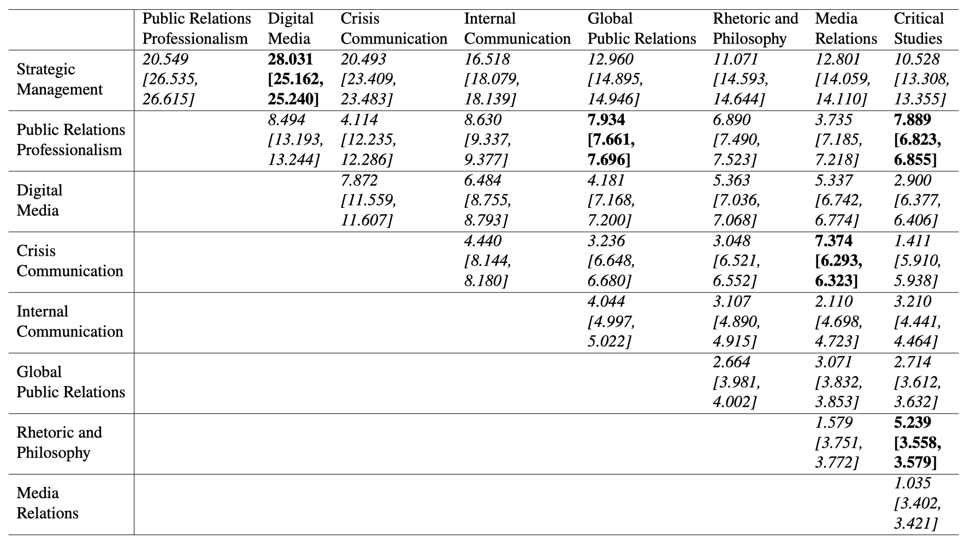
Network as structures for other inquiries
Bold: Tie Strength Stronger Than Expected & Italic: Tie Strength Weaker Than Expected
Notes:
We find that across all 36 ties, 31 ties are significantly weaker than what was simulated, suggesting that the landscape of PR research for the past decade has much less inter-paradigmatic knowledge than what would have been expected.
So we are basically saying that different subfields within PR should talk more with each other, creating more interconnections between subfields.

Slide 38
Network as structures for other inquiries
Sohn, D. (2022). Spiral of silence in the social media era: A simulation approach to the interplay between social networks and mass media. Communication Research, 49(1), 139–166.
Kim, S. (2019). Directionality of information flow and echoes without chambers. PLOS ONE, 14(5), e0215949.
Song, H., Eberl, J.-M., & Eisele, O. (2020). Less fragmented than we thought? Toward clarification of a subdisciplinary linkage in communication science, 2010–2019. Journal of Communication, 70(3), 310–334.
Centola, D., Becker, J., Brackbill, D., & Baronchelli, A. (2018). Experimental evidence for tipping points in social convention. Science, 360(6393), 1116–1119.

Slide 39
Thank You!
Alvin Zhou
alvinyxz@umn.edu
@alvinyxz

